Slide 1
Project 2 Rental Home Prediction
Leo Liu

Slide 2


Objective
Evaluate a property
Budget your rental

Slide 3
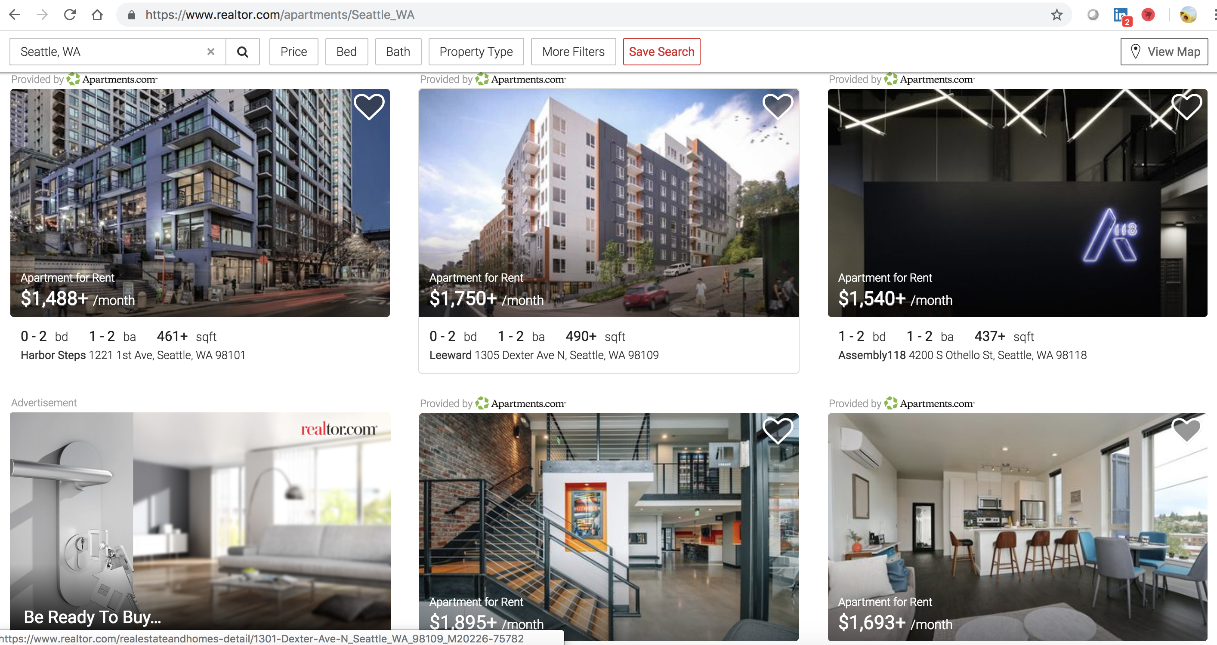
Data Source

Slide 4


Process
1
Web Scrapping
2
Data Cleaning
Get URLs
Iterate over pages
Scrap each single page
Account for only popular community and unit features
3
Modeling
4
Training & Testing
MVP
Feature Screening
Polynomial Features
Variable Transformation
Check overfitting

Slide 5
Model
Features:
Responses:
Rental Price
Bedrooms | Bathrooms
Sqft | YearBulit
Schools | Average School Rating
Community Features | Unit Features
Median Rental Price | Median Listing Price

Slide 6
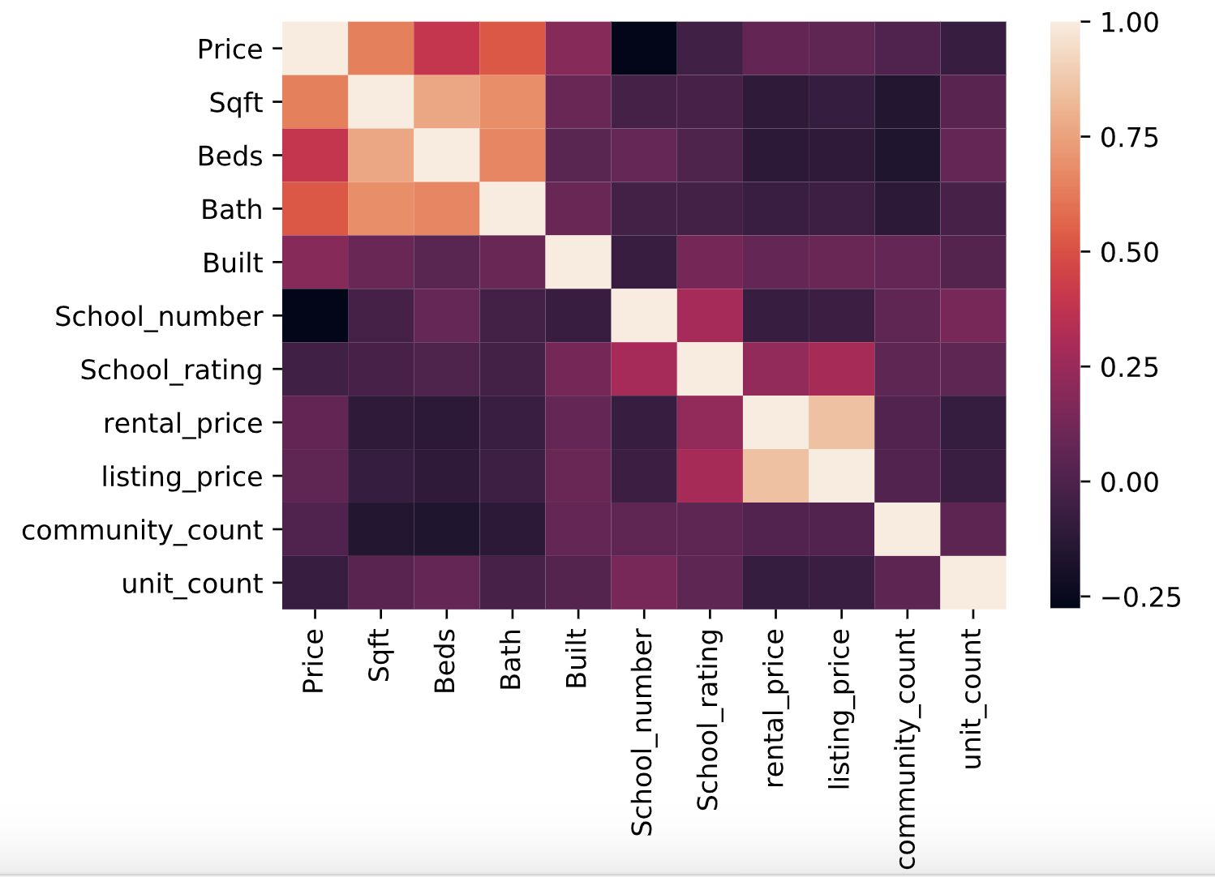
Model
Check multicollinearity

Slide 7
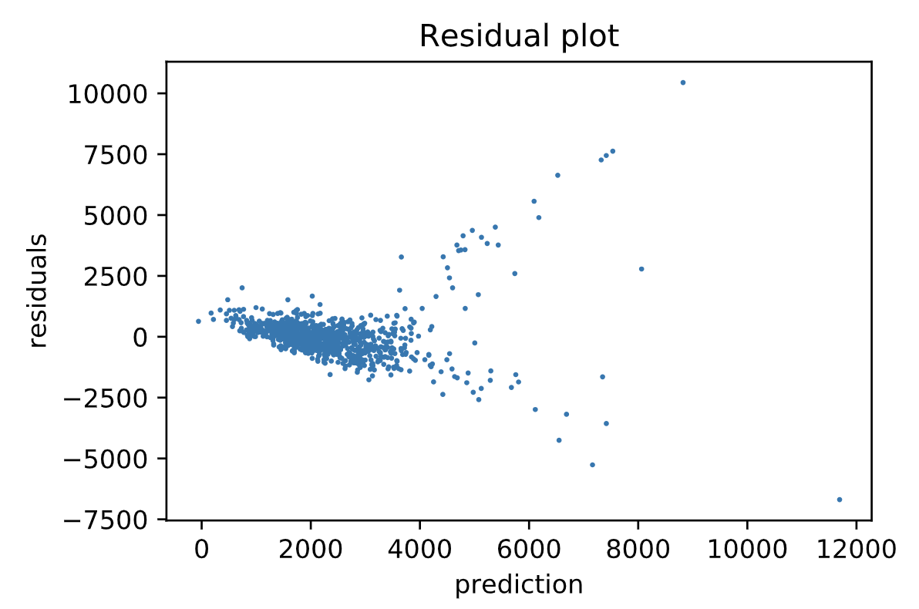
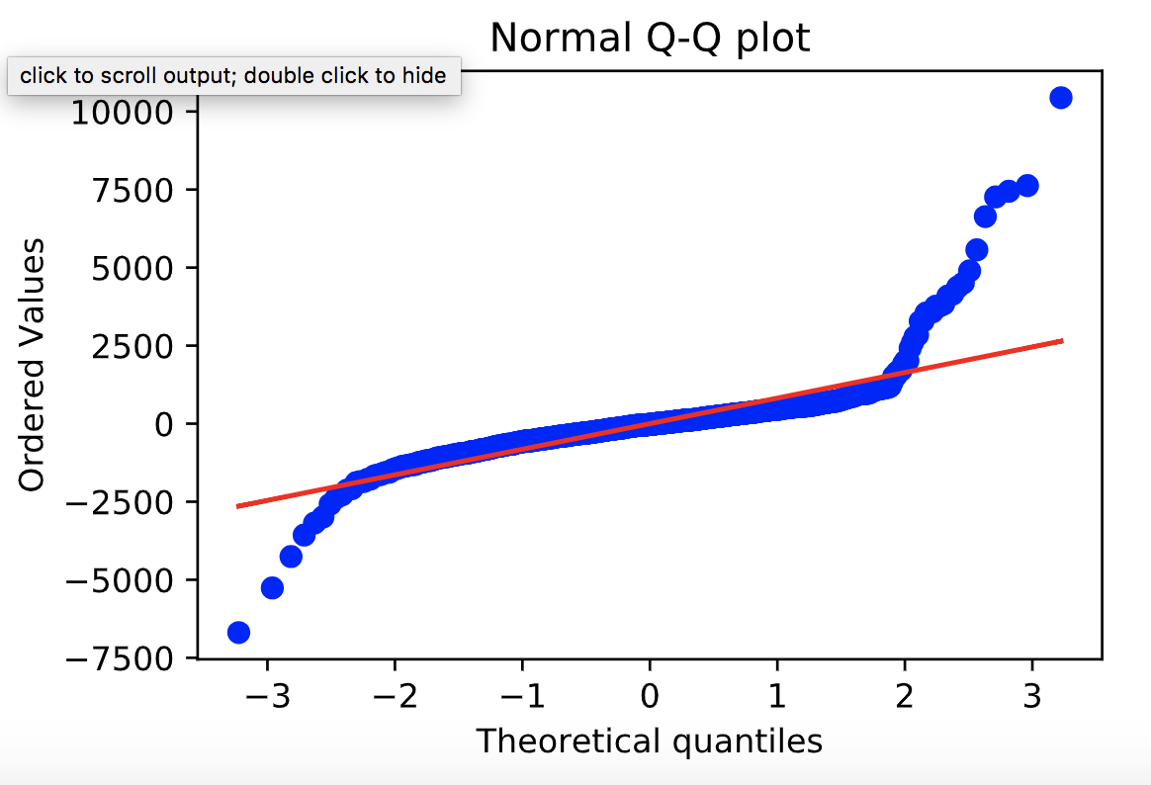
Model
Check heteroskedasticity
Residual plot and Normal Q-Q plot of 2-degree polynomial feature regression model

Slide 8
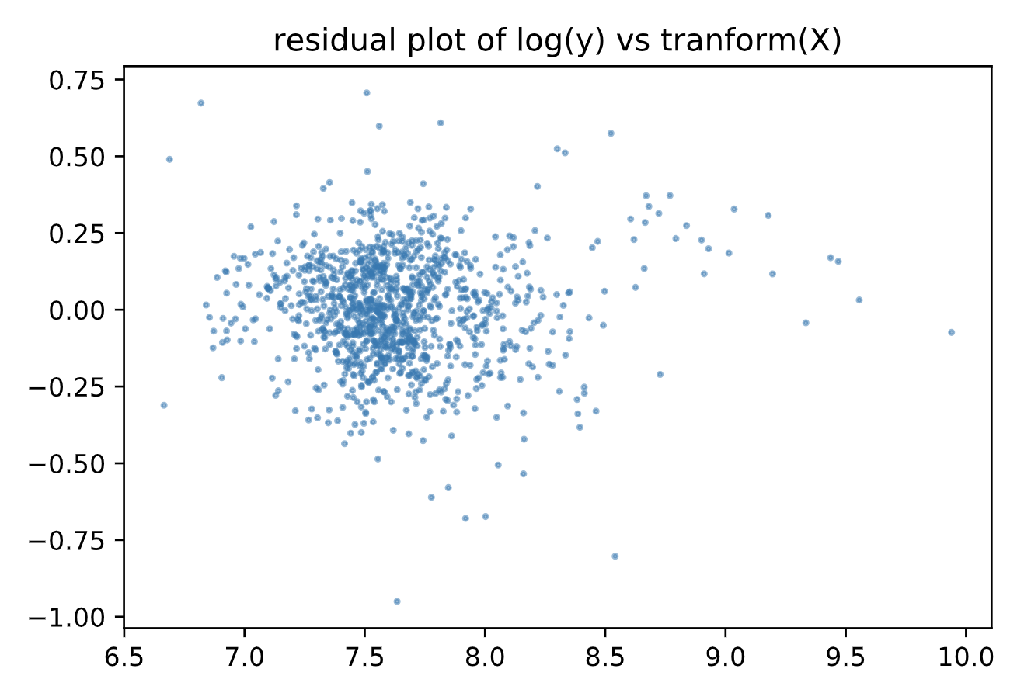
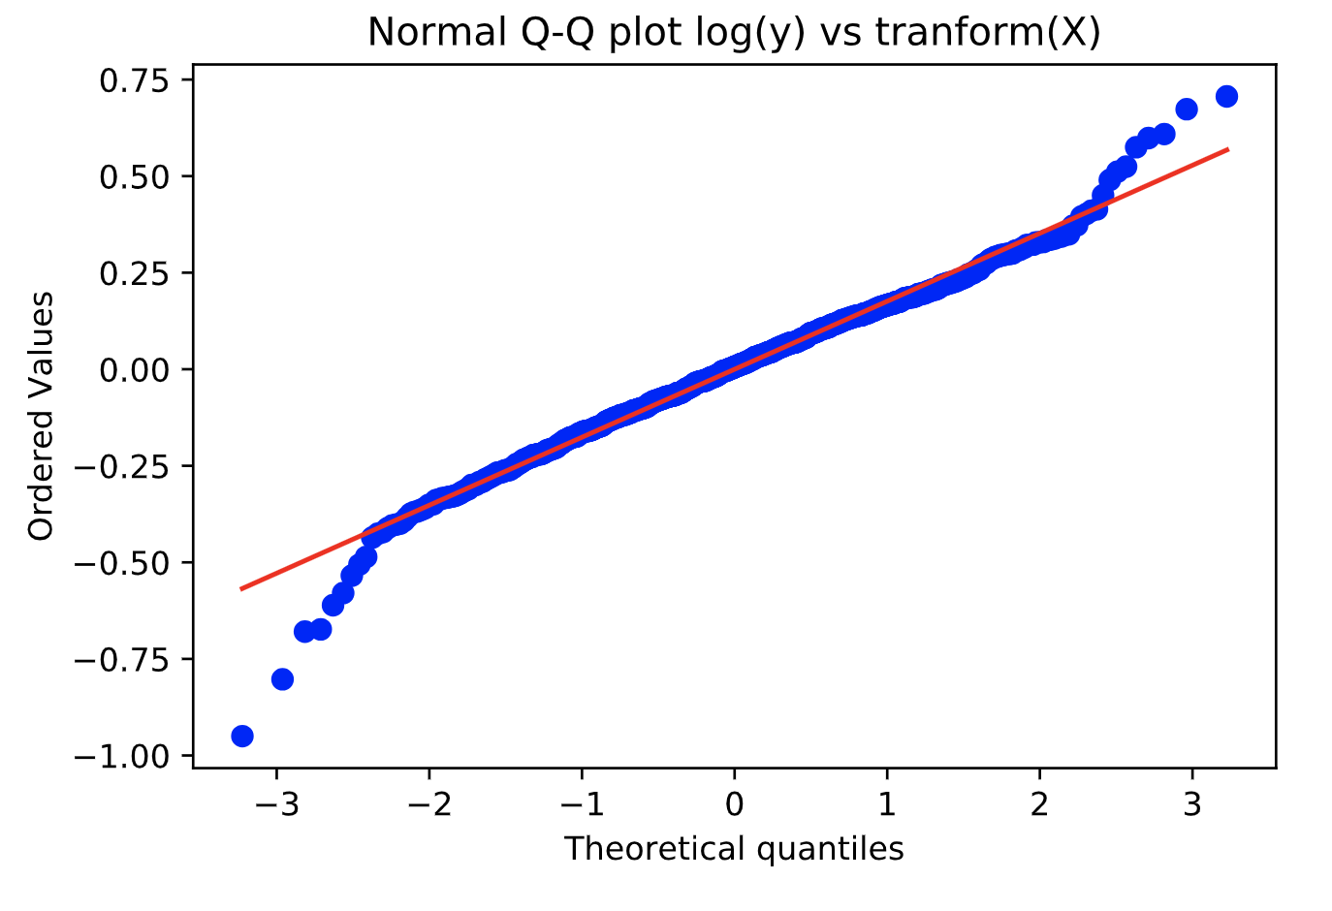
Model
Check heteroskedasticity
Residual plot and Normal Q-Q plot of 2-degree polynomial feature regression model with transformed variables

Slide 9
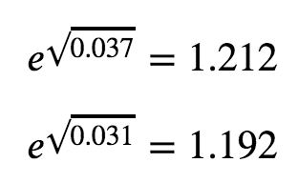
Train and Test
Cross Validation on Training Data
R-Squared = 0.730 +/- 0.033
Mean Squared Error = 0.041 +/- 0.010
Check Overfitting
R-Squared(Train) = 0.791
R-Squared(Test) = 0.780
Mean Squared Error(Train) = 0.031
Mean Squared Error(Test) = 0.037
So the final deviation between train and test is about 1.212/1.192 - 1 ≈ 1.6%

Slide 10
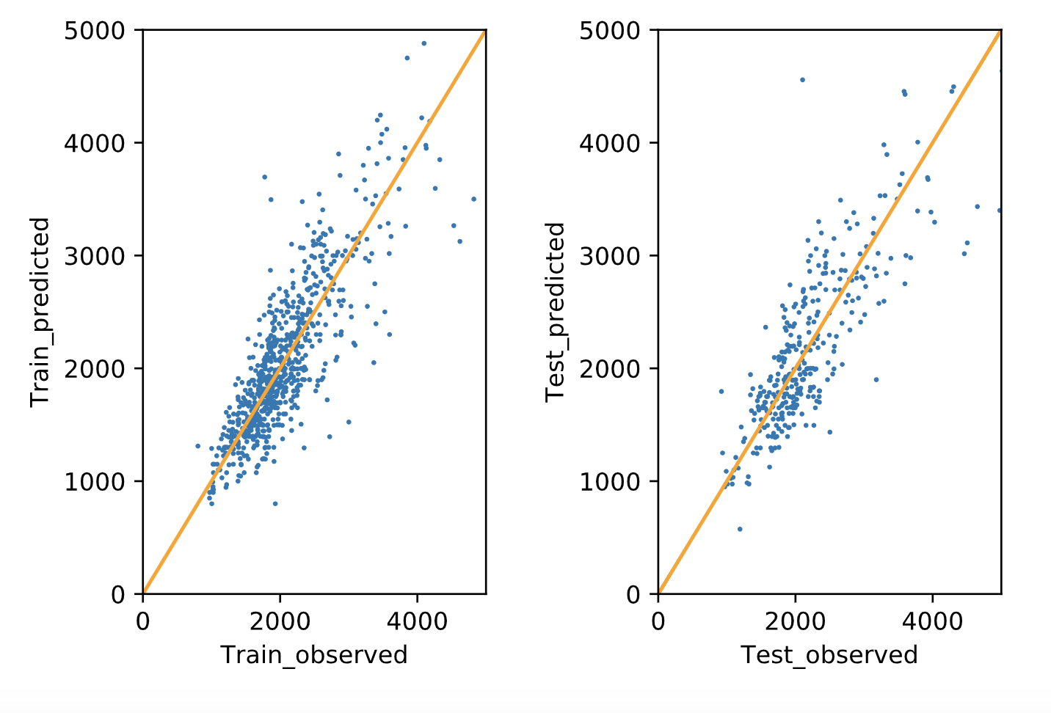
Train and Test
Train & Test Prediction vs. Observation

Slide 11
Future Work
Increase dataset
Incorporate more features
Create customized models for different property types

Slide 12
Thank You!

Slide 13
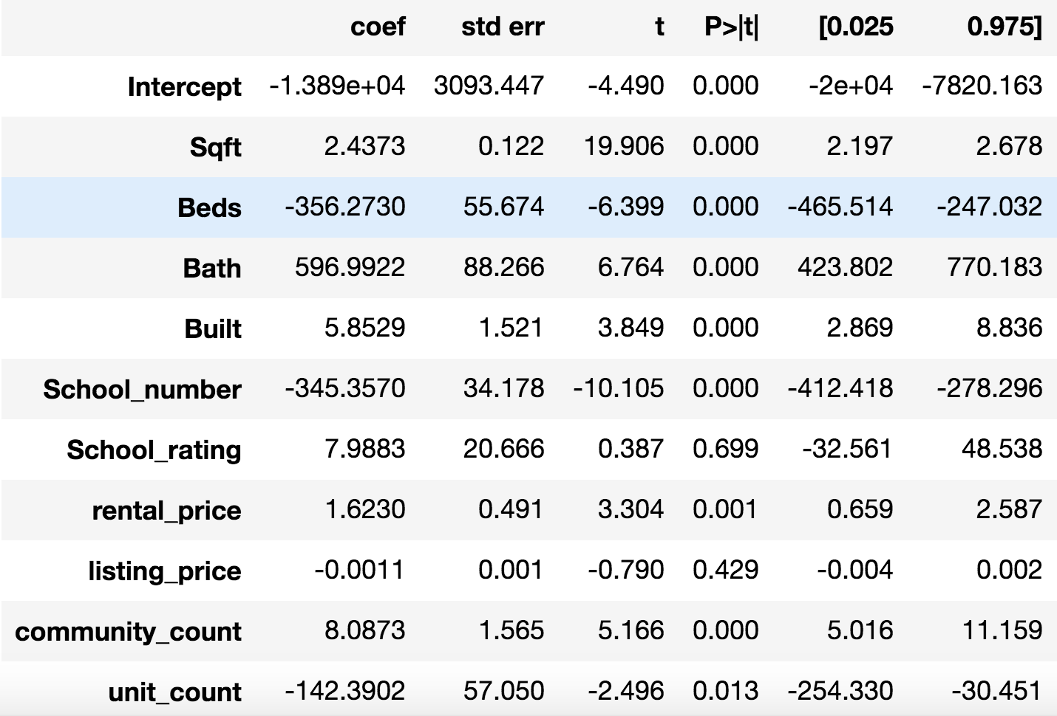
Appendix
Check p-values

Slide 14
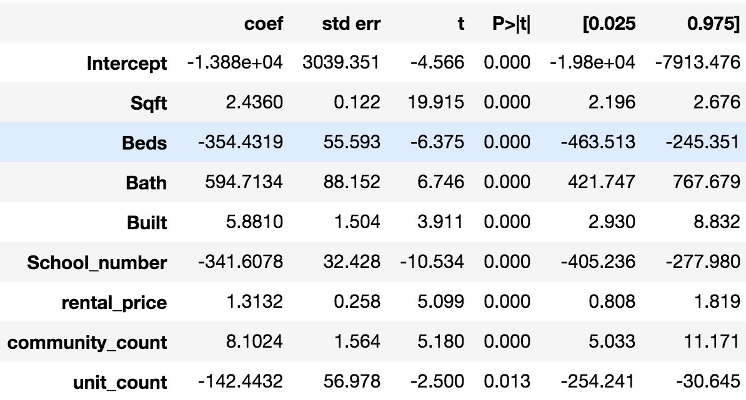
Appendix
Feature Screening

Slide 15
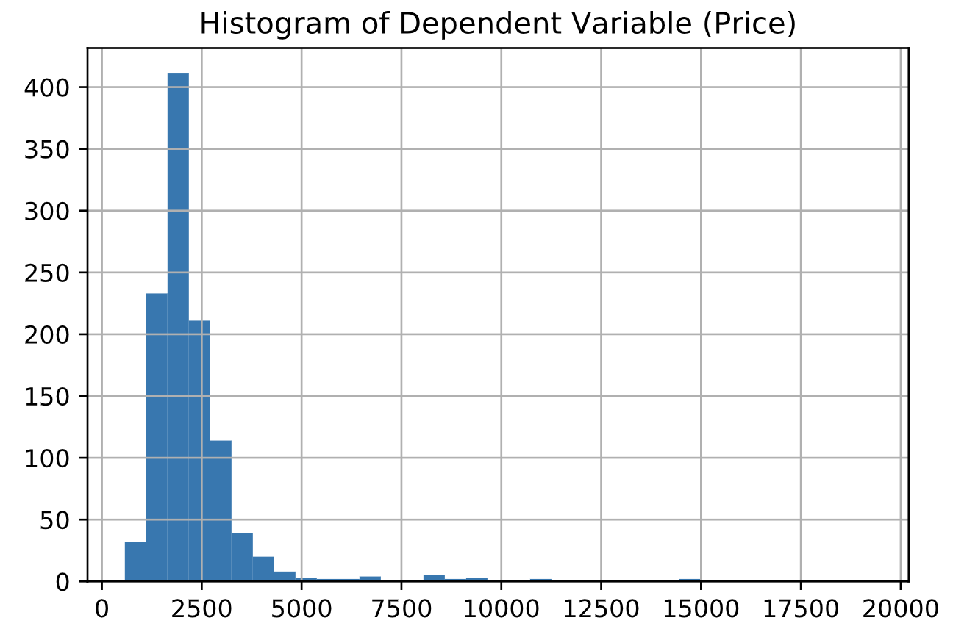
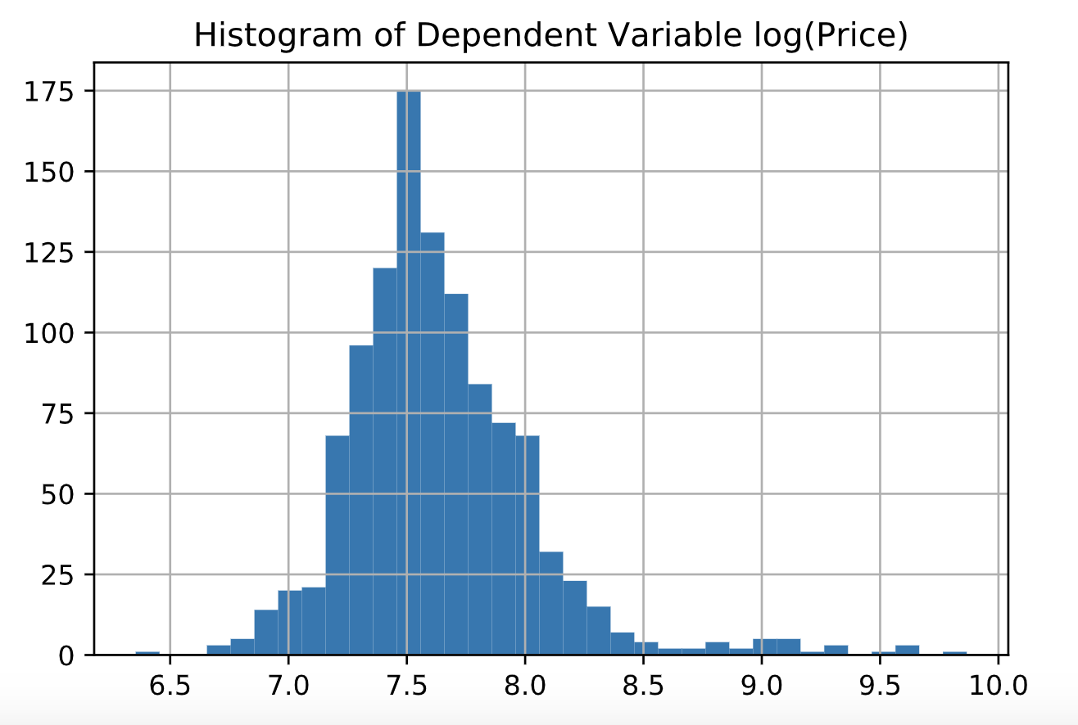
Appendix
Check heteroskedasticity
Distribution of y and log(y)

Slide 16
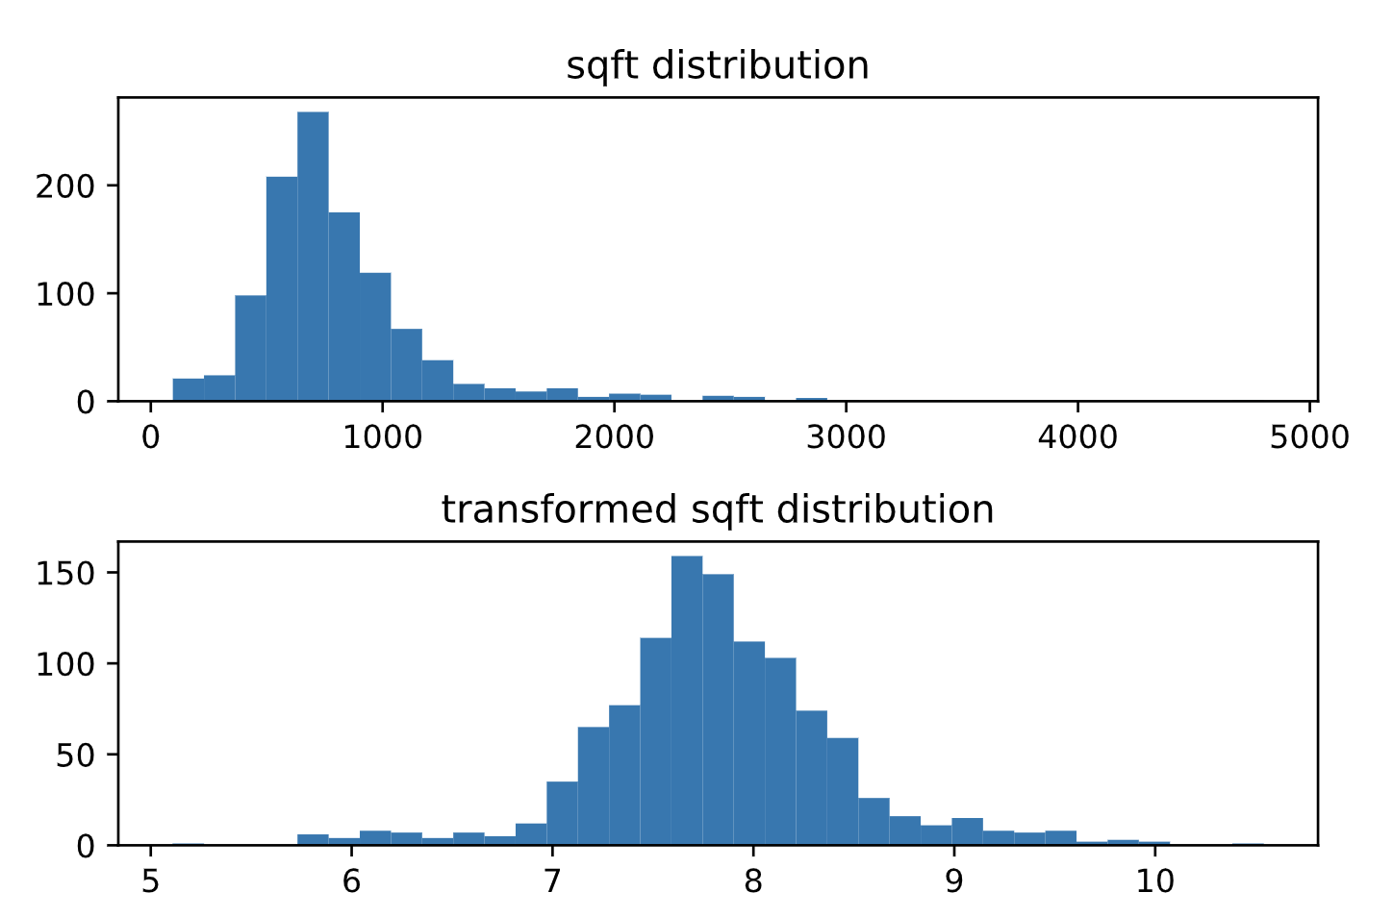
Appendix
Check heteroskedasticity
Distribution of Sqft and Boxcox transformed Sqft

